Slide 1

Android
A brief Introduction

Slide 2
Main Topics
Introduction
Platform
IDE and Tools
Applications Development Walkthrough
Overall evaluation

Slide 3
What is Android ?
A software platform and operating system for mobile devices
Based on the Linux kernel
Developed by Google and later the Open Handset Alliance (OHA)
Unveiling of the Android platform was announced on 5 November 2007 with the founding of OHA

Slide 4


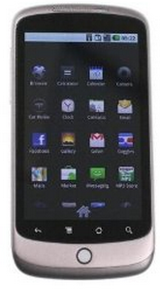
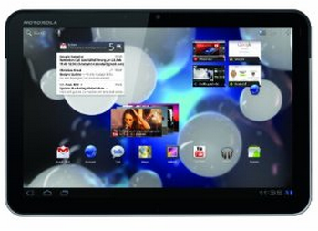
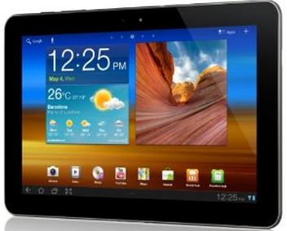


Slide 5

Why Android ?

Slide 6
300 million Android devices
9,50,000 daily activations
Open Source

Slide 7
Android’s market share has doubled from 25.3% to the current 52.5% share of the total market.

Slide 8
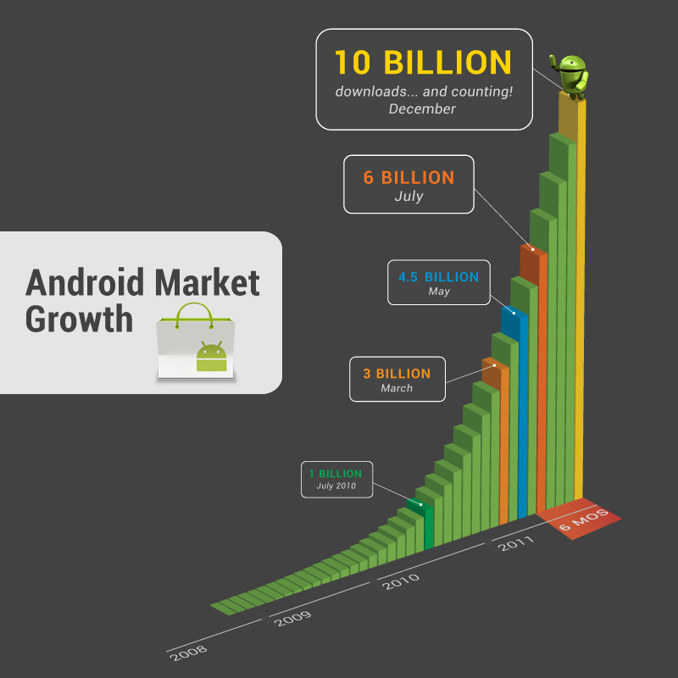

Slide 9
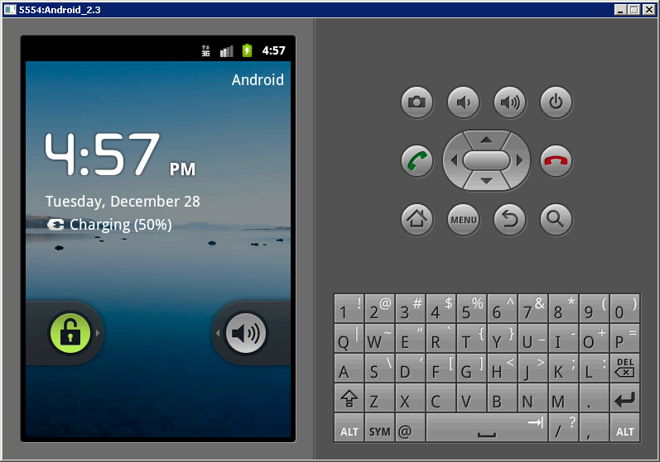
Android Emulator

Slide 10
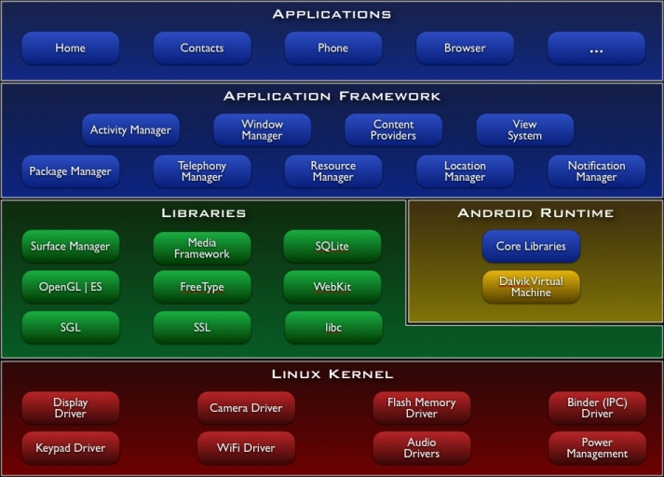
Android Architecture

Slide 11
Basic Components
Activities
Services
Content providers
Broadcast receivers

Slide 12
Programming Languages support
Java – officially supported
C/C++ – also possible but not supported
<number>

Slide 13
Development requirements
Java
Android SDK
Eclipse IDE (optional)
<number>

Slide 14
IDE and Tools
Android SDK
Eclipse IDE + Android Development Tools (ADT) plug in
Other IDEs
Tools for debugging, compiling and packaging
<number>

Slide 15

Summary
Android powerful and well-designed development platform
Marketleader for Smartphones
Power to the developer

Slide 16
Questions

